Slide 1


Python Full-Stack Internship Final Presentation
ABDUL Team Members: Nithish, Niveditha, Vishal Internship Duration: Feb 17 – June 17

Slide 2

Introduction
Education, Background
I am currently pursuing a Computer Science and Engineering degree from Mangalore Institute of Technology and Engineering . I have hands-on experience in software development and contributed to building a Car Rental Management System during my internship. My technical skills include React.js for frontend development, and I am currently working on integrating the backend using Flask and MySQL.
What you aimed to achieve
The objective of my internship was to apply theoretical knowledge to practical software development tasks. I aimed to strengthen my frontend skills using React, gain hands-on exposure to Python and Flask for backend development, and contribute meaningfully to building a functional Car Rental Management System under the mentorship of DLithe Consultancy Services.
Short introduction about the company
Academic Institutions, since the year 2018. With experiences drawn from corporate time, the foundation of DLithe is built to innovate products that transform the upcoming generation. Our expertise in Embedded Systems, Robotics, Internet of Things, Cyber Security, and Artificial Intelligence is helping academics institutions to align with industry needs. Since inception, we have established 8 development centers enabling student community to work on research and development. Our services to IT companies have reduced the hiring cycle time and led to cost effective measures to source the best talent from on and off campus. We have transformed many lives by imparting 360 degree learning – Domain, Process & Technology, keeping focus on Customer Experience and Operational Excellence objectives. We are proud to say, DLithe is a bootstrap company with strong foundation, experience, trust and commitment to build an agile workforce towards industry need.

Slide 3
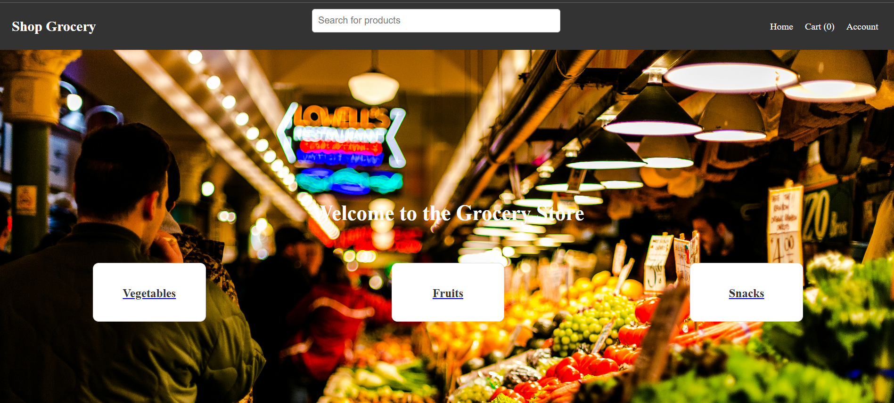
Project Title
React based Car Rental Management System
The project involved developing a Car Rental Management System where users could browse available vehicles, register/login, and manage their bookings . The system is designed to streamline the rental process through a responsive and user-friendly interface built using React. Backend integration with Flask (in progress) will handle API endpoints, authentication, and data processing. MySQL is planned for managing vehicle, user, and booking records. The platform aims to simplify vehicle rentals for both customers and administrators while supporting scalability and real-time data operations.
Objective/Purpose of the Project
The objective of the Car Rental Management System project was to build a user-friendly web application that allows customers to easily book rental vehicles online. The goal was to provide a modernized and efficient vehicle booking experience, reduce manual processing, and ensure smooth customer and fleet management. The system streamlines operations like vehicle listings, bookings, and customer profiles using a React.js frontend and a Python Flask backend, delivering a responsive and scalable rental platform.

Slide 4




Technology Stack
Frontend
Backend
The frontend was built using React and JSX for reusable components, with CSS3 for styling
The backend is being developed using Python Flask and is currently in progress
Database
Other Tools
MySQL for managing
structured data.
Postman will be used to test and validate the REST APIs once the backend development is complete, ensuring smooth integration with the frontend.

Slide 5
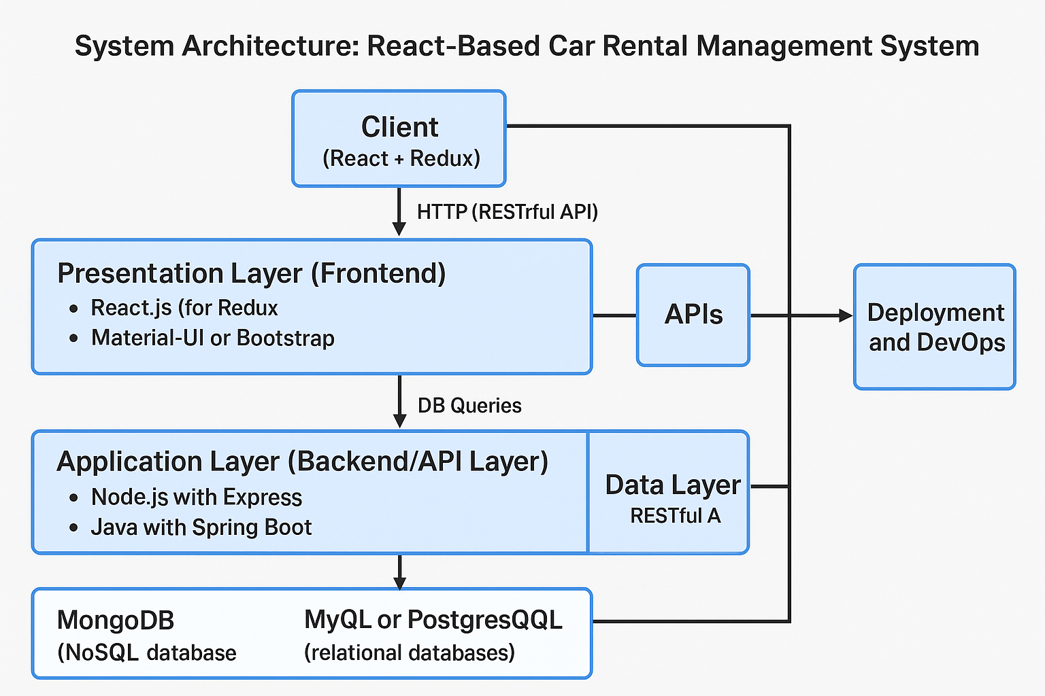
System Architecture
High-Level Architecture Diagram:
The architecture consists of three main layers:
Frontend: Built using React with Vite and styled with CSS. The frontend interacts with the backend via RESTful APIs to display dynamic data (like products, user details, and orders).
Backend: Built using Spring Boot, which provides RESTful APIs to handle client requests from the frontend. Spring Boot also interacts with the MySQL database for data storage and retrieval.
Database: MySQL is used to store and manage all data, such as user information, product listings, and order details.

Slide 6


Frontend Development
Key Features Implemented
UI Technologies Used
Reusable Components: Built modular UI elements like vehicle cards, forms, and navigation bars for better maintainability.
Dynamic Rendering: Used state and props to update the UI based on user input and application state.
Responsive Design: Styled the interface to work smoothly across mobile, tablet, and desktop screens.
Interactive Elements: Added hover effects, live feedback, and dynamic views for a better user experience.
React: A JavaScript library used for building dynamic and responsive user interfaces. It enables the creation of modular, reusable components and ensures smooth rendering of data-driven views in the Car Rental Management System.
CSS: Utilized for styling the application’s components, controlling layout, color schemes, fonts, and responsiveness. CSS3 helped create a visually appealing and mobile-friendly user experience.

Slide 7
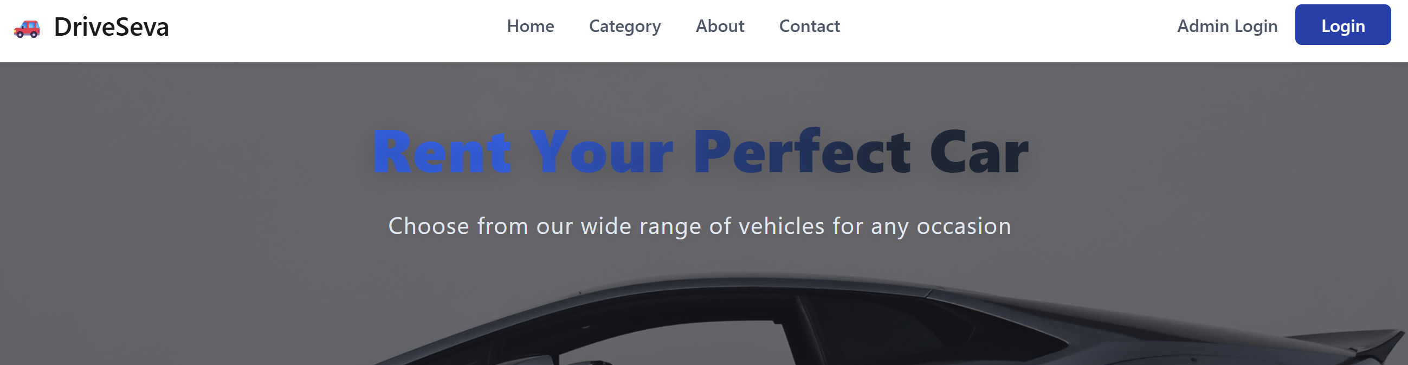
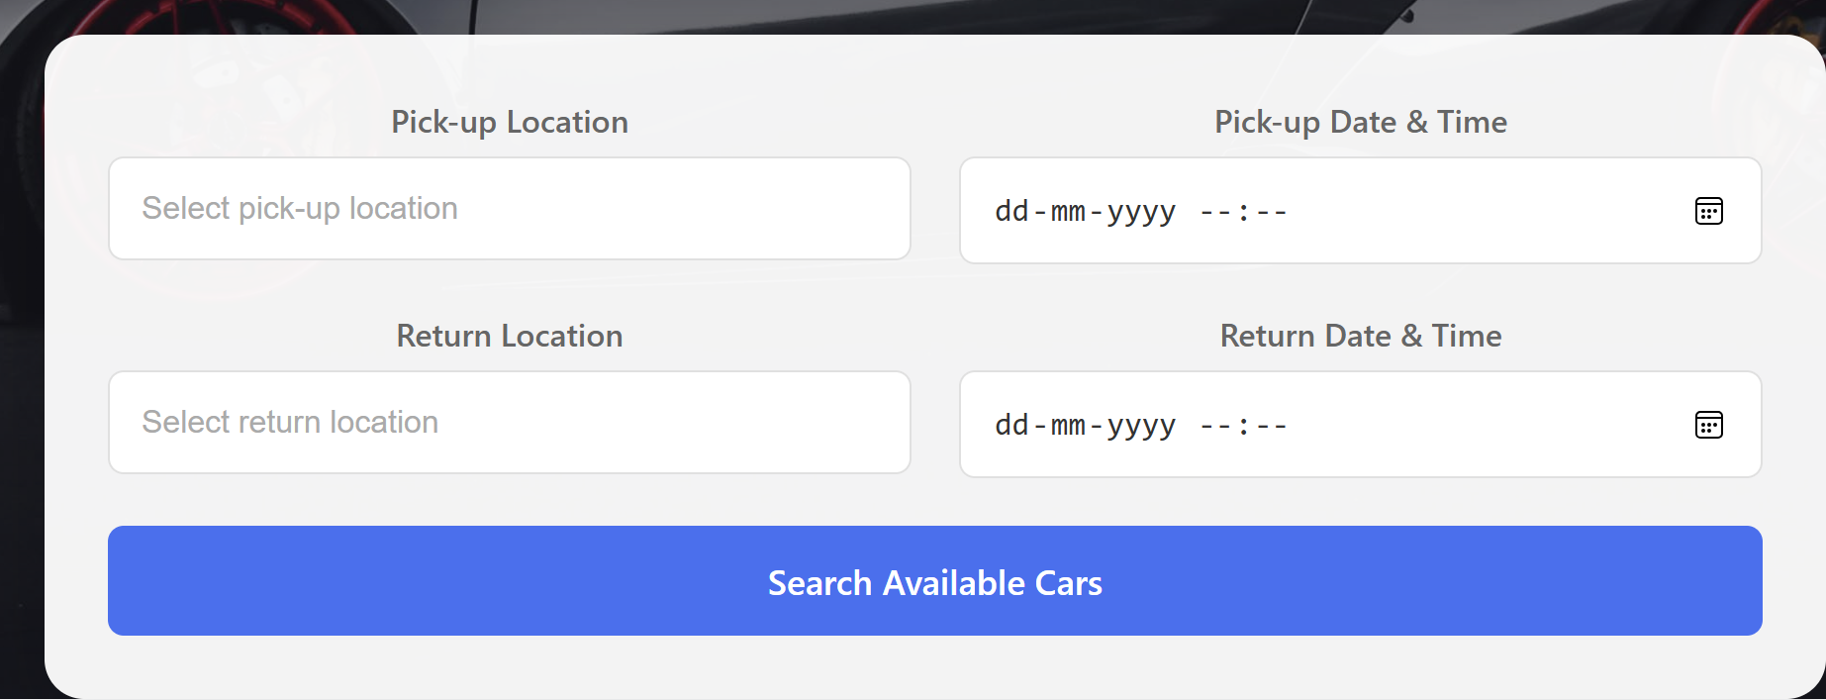
Frontend Development

Slide 8
Backend Development Overview
Flask :
Key Functionalities Developed
Database Integration
User Authentication & Authorization:
JWT-based authentication for secure user sessions.
Role-based authorization for controlling access to resources.
CRUD Operations:
Endpoints for Create, Read, Update, and Delete functionalities.
Handling HTTP methods: POST, GET, PUT, DELETE.
Entity: Product (mapped to a products table).
Repository: ProductRepository extends JpaRepository.
CRUD operations available via repository methods.
A lightweight framework for building Python-based RESTful APIs. Simplifies routing and backend logic, enabling quick development. Supports extensions for features like authentication, database integration, and API structuring.

Slide 9
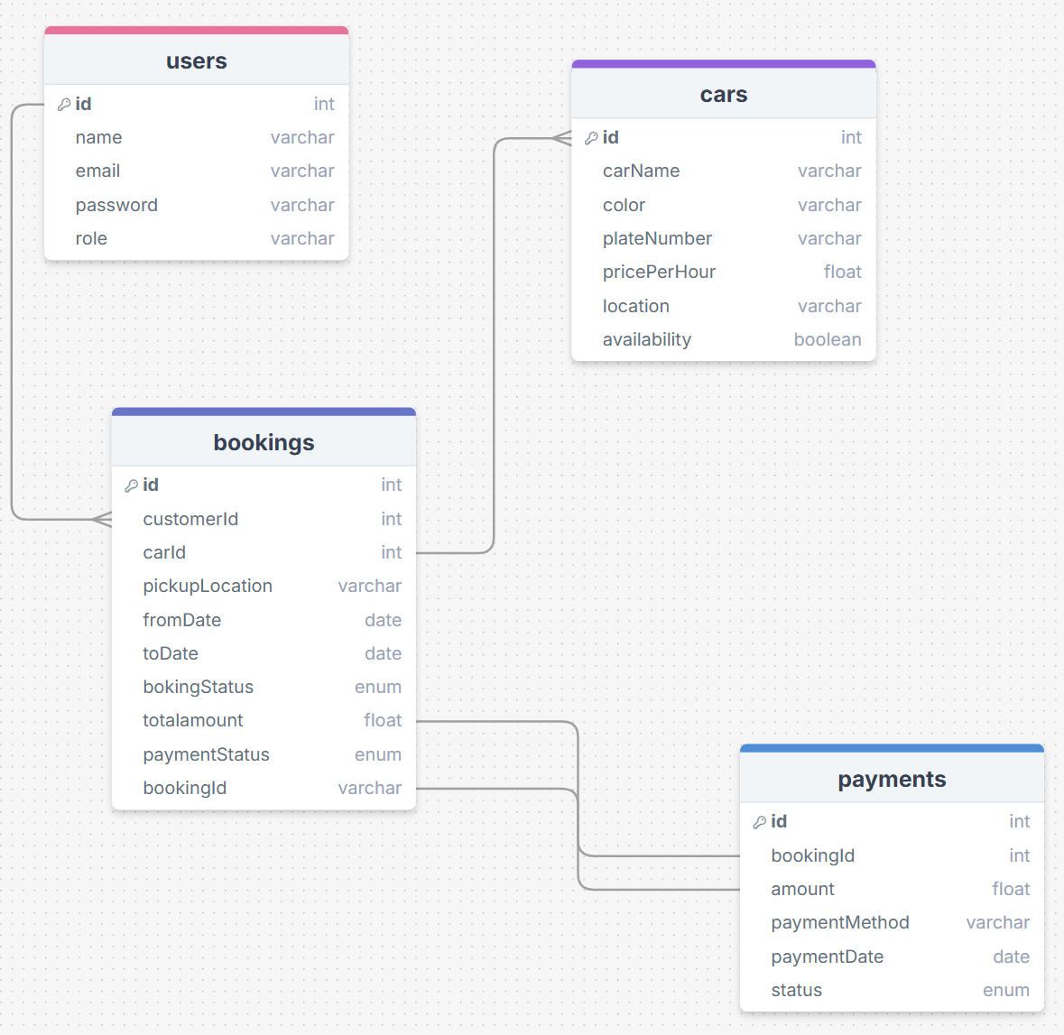
Database Design

Slide 10
Database Design
Tables & Relationships
Purpose:
Design a relational database schema to support a Car Rental System using Spring Boot REST APIs. This schema will:
Manage users, cars, bookings, and payments.
Ensure data integrity via relationships and constraints.
Enable efficient querying of available cars, bookings, and transactions.
Support enum-based status tracking for bookings and payments.
Tables | Columns | Relationships
Users | iid (PK), name, email, password, role | One-to-Many with Orders
Cars | id (PK), carName, color, plateNumber, pricePerHour, location, availability | Many-to-One with Categories, Many-to-Many with Orders (via OrderItems)
Bookings | id (PK), customerId (FK), carId (FK), pickupLocation, fromDate, toDate, bookingStatus, totalAmount, paymentStatus, bookingId (string) | id (PK), user_id (FK), order_date, status, total_price
Payment | id (PK), bookingId (FK), amount, paymentMethod, paymentDate, status | Many-to-One with Orders, Many-to-One with Products
Mysql
CREATE DATABASE car_rental_db;
USE car_rental_db;
CREATE TABLE users (
id INT AUTO_INCREMENT PRIMARY KEY,
email VARCHAR(255) UNIQUE NOT NULL,
password VARCHAR(255) NOT NULL
);
SELECT * FROM car_rental_db.users;

Slide 11
API Development Overview
Goal:
Develop RESTful APIs using Flask for a smooth client-server interaction.
Provide secure, error-free, and efficient endpoints to handle CRUD operations.
Tools Used:
Flask: To build REST APIs.
Postman: For testing the APIs.
RESTful API Endpoints:
User Management:
POST /api/users/login: Log in a user using email and password.
POST /api/users/register: Register a new user (name, email, password).
Vehicle (Car) Management:
GET /api/vehicles: Retrieve all available cars.
GET /api/vehicles/{id}: Get car details by ID.
POST /api/vehicles: Add a new car listing.
PUT /api/vehicles/{id}: Update car details.
DELETE /api/vehicles/{id}: Remove a car from the system.
Booking Management:
GET /api/bookings: View all bookings (admin).
GET /api/bookings/{id}: View a specific booking by ID.
POST /api/bookings: Create a new booking (select car, dates, user).
PUT /api/bookings/{id}: Update a booking status(Pending,Confirmed,Cancelled).
DELETE /api/bookings/{id}: Cancel and delete a booking.
Payment Management:
GET /api/payments: Get all payment transactions.
GET /api/payments/{id}: View a payment by ID.
POST /api/payments: Make a payment for a booking.
PUT /api/payments/{id}: Update payment status(Pending,Completed,Failed).

Slide 12
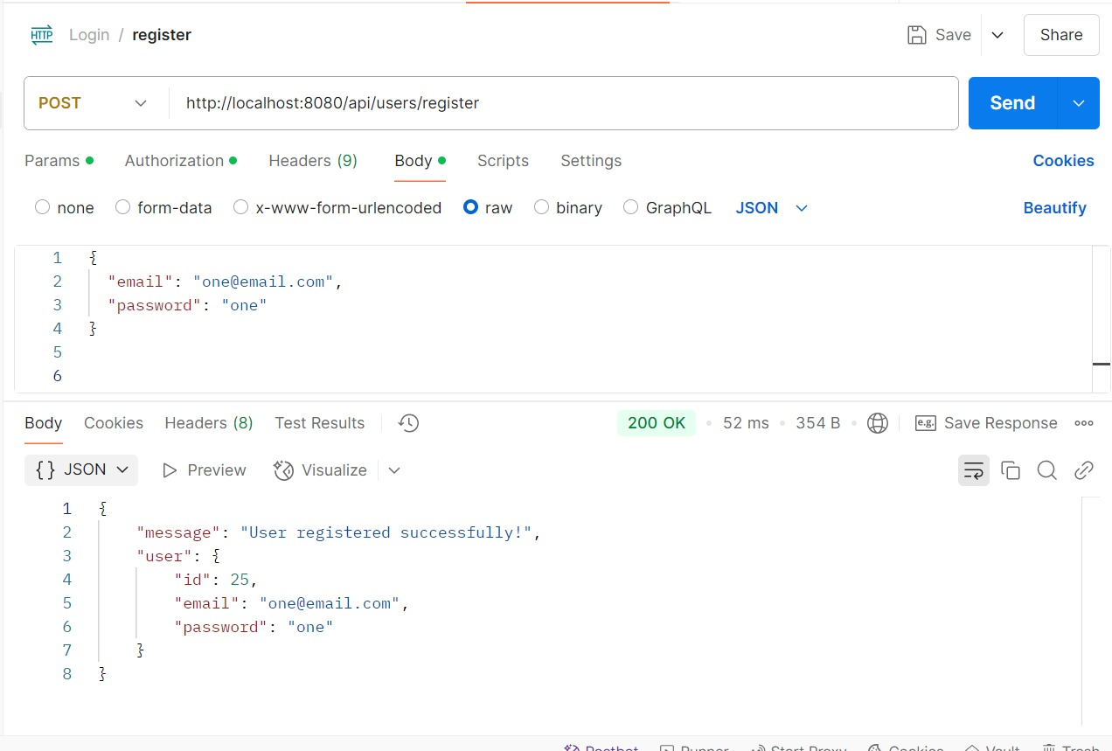
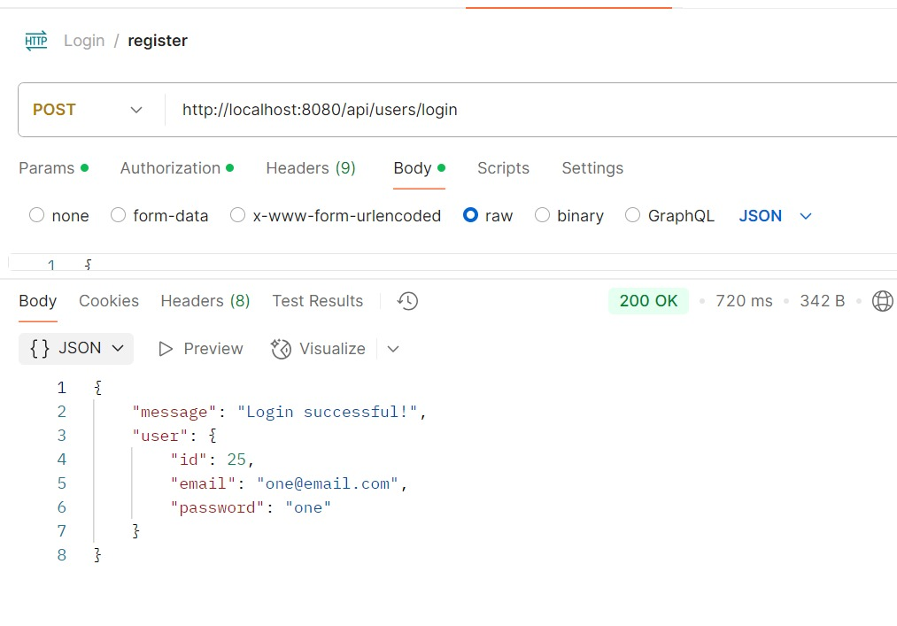
API Development Overview

Slide 13
Challenges Faced
Technical Challenges
Debugging Complex Issues:
Challenge:
Expected issues with API request handling, data binding, and logic flow once backend is built.
Solution:
Used Postman and Spring Boot’s built-in logging to trace API requests and debug issues.
Employed unit and integration tests to isolate problems.
Performance Bottlenecks:
Challenge:
Slow API responses, especially when querying large datasets, affecting the user experience.
Solution:
Implemented pagination and sorting in GET requests to handle large datasets efficiently.
Optimized database queries with indexing and selecting only necessary fields.
Database Integration:
Challenge:
Issues with configuring foreign key relationships correctly in Spring Data JPA, resulting in constraint violations.
Solution:
Thoroughly reviewed JPA annotations (@ManyToOne, @OneToMany) to ensure correct relationship mapping.
Used database migration tools (Flyway) for smooth schema updates.

Slide 14
Leanings from Internship
Technical Skills Acquired
Gained proficiency in Spring Boot for backend API development.
Enhanced knowledge of React and React Native for frontend development.
Learned database management and integration with Spring Data JPA and MySQL.
Gained hands-on experience with JWT for secure API authentication.
Soft Skills Improved
Team Collaboration: Improved teamwork through peer programming and knowledge-sharing sessions.
Communication: Enhanced ability to clearly convey ideas and technical concepts with teammates and mentors.
Time Management: Balanced multiple tasks and deadlines effectively, ensuring timely project delivery.
How This Internship Helped Your Career
Gained industry-relevant skills in full-stack development (React, Spring Boot, and databases).
Improved problem-solving and debugging skills by working on real-world challenges.
Enhanced career prospects by working in a team environment, learning from experienced mentors, and gaining exposure to best practices.

Slide 15
Future Scope & Improvements
Enhancements for the Project
Performance Optimization: Implement caching mechanisms and optimize API responses.
User Experience (UX) Enhancements: Improve the UI/UX of the application for better accessibility and user flow.
Security: Further enhance security with features like role-based access control (RBAC) and OAuth.
Potential Next Steps
Add advanced features like search and filter options for users and products.
Implement real-time notifications (e.g., for order updates) using WebSockets.
Conduct a thorough testing phase with automated tests and load testing.
What You Plan to Learn Next
Microservices Architecture: Learn to develop microservices using Spring Cloud and Docker.
Advanced Frontend Development: Improve React skills with Next.js and State Management (e.g., Redux, Context API).
Cloud Deployment: Learn to deploy applications on AWS or Azure for scalability.

Slide 16
Conclusion & Acknowledgment
Summary of Internship Experience
Gained hands-on experience in full-stack development with real-world challenges and collaborative teamwork.
Developed core technical skills and improved soft skills like communication, problem-solving, and time management.
Learned key industry practices and built a solid foundation for future projects and career growth.
Gratitude to Mentors & Team
A special thank you to my mentors for their guidance and support throughout the internship.
Grateful to my team for their collaboration, learning together, and working toward common goals.

Slide 17
Queastion & Answer
Encourage Audience to Ask Questions
Feel free to ask any questions or clarifications.
Happy to discuss anything related to the internship,
projects, or technologies used.

Slide 18

Thank
You

